Slide 1

Support Vector Machine & Discrete Wavelet Transform Based Fault Detection of Induction Motor
Presented by:
Abdullah Al Baki Sifat (ID: 201891725)
Mohammad Zaid Kamil (ID: 201599045)
Memorial University Of Newfoundland Faculty Of Engineering & Applied Science
St. John's, NL, Canada

Slide 2
1. Objectives
2. Discrete Wavelet Transform
3. Support Vector Machine
4. Methodology
5. Results
5. Conclusion
Notes:
Firstly, followed by, then ,finally, .

Slide 3
OBJECTIVES
Train Support Vector Machine (SVM) model using offline data.
To detect, identify and isolate two kinds of faults in induction motor.
Implementation of the trained SVM model to detect faults in online system in future work.

Slide 4
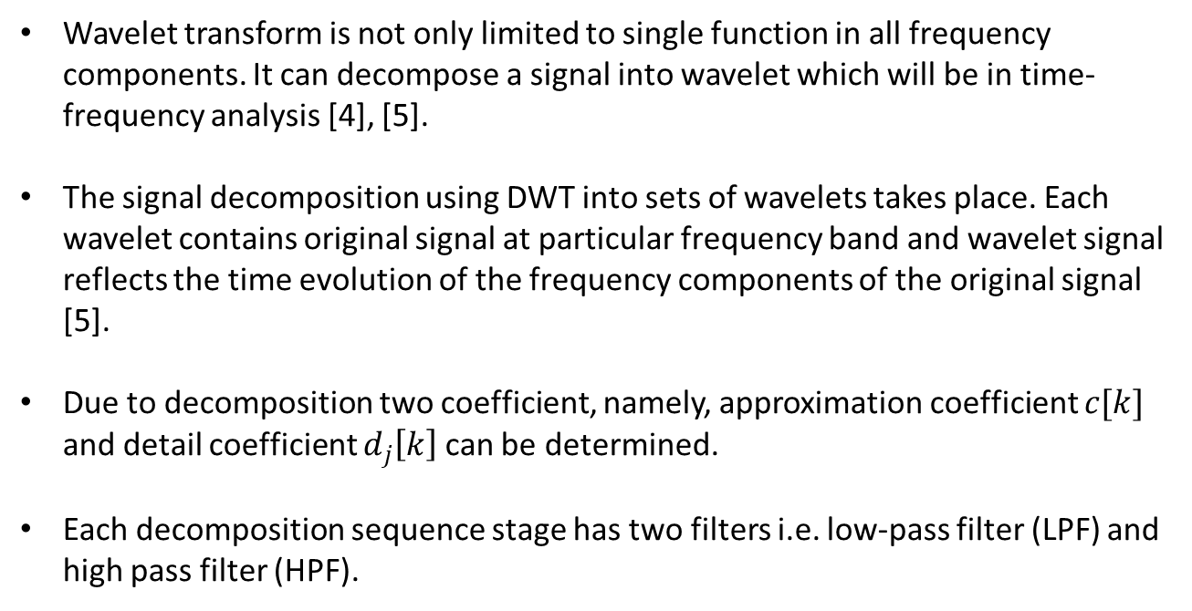
DISCRETE WAVELET TRANSFORM
Wavelet transform is not only limited to single function in all frequency components. It can decompose a signal into wavelet which will be in time-frequency analysis [4], [5].
The signal decomposition using DWT into sets of wavelets takes place. Each wavelet contains original signal at particular frequency band and wavelet signal reflects the time evolution of the frequency components of the original signal [5].
Due to decomposition two coefficient, namely, approximation coefficient $c[k]$ and detail coefficient $d_{j}\left[k\right]$ can be determined.
Each decomposition sequence stage has two filters i.e. low-pass filter (LPF) and high pass filter (HPF).

Slide 5
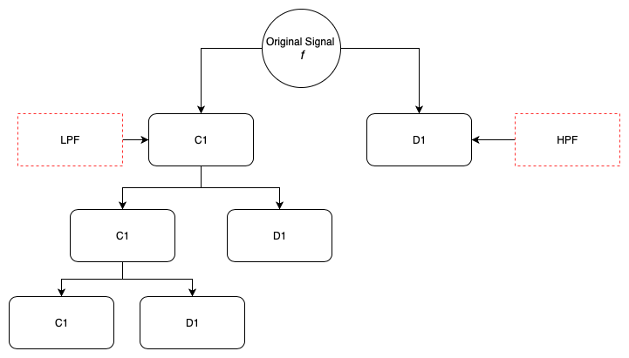
DISCRETE WAVELET TRANSFORM
Decomposition of original signal into set of wavelets

Slide 6
SUPPORT VECTOR MACHINE
Support Vector Machines (SVM) are classification and regression tool which have been derived from statistical learning theory.
The success of SVMs starts when they do not require an estimation of statistical distributions of classes to carry out the classification task, but they define the classification model by exploiting the concept of margin maximization [10].
Compared to other approaches such as Artificial Neuron Network, SVMs exhibit higher generalization capability.
In this project kernel function of SVMs used.

Slide 7
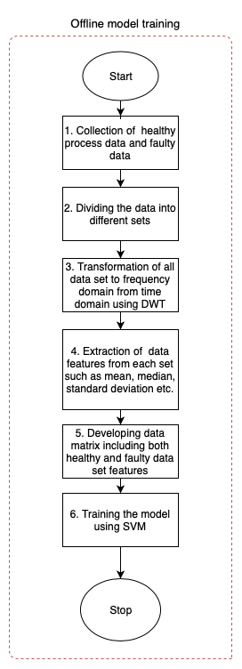
METHODOLOGY
Collected data (90,000 data points of phase 2 current signal & 90,000 data points of z-axis vibration) is divided into 10 different sets, respectively.
In each set DWT is applied to convert it into the frequency domain and extract the features of it.
We train the data-driven model using different sets of data, each set consist of healthy, broken rotor fault and bearing fault.
Offline model training

Slide 8
METHODOLOGY
Wavelet Analyzer application in MATLAB is used to perform DWT on the experimental data obtained from [DWT].
Each set of data of phase 2 current is analyzed and statistical features are collected, consisting of healthy data (10 sets of data), bearing fault (10 sets of data) and broken rotor bar fault (10 dets of data). Similarly, for z-axis vibration data, the same procedure has been applied.
One dimensional
Wavelet 1D
Db4 level 6
Statistics
Synthesized signal
Steps performed in wavelet analyzer application

Slide 9
METHODOLOGY
List of statistical features collected for each data of set:
Mean
Median
Standard Deviation
Maximum
Minimum
Median Absolute Deviation
Mean Absolute deviation
L1 Norm
L2 Norm
Maximum Norm
SVM benefits from higher number of statistical features.
Final data used for SVM model training is a 30x11 matrix.

Slide 10
RESULTS
Features from the data sets are used to train the SVM classifier with 5-fold cross-validation.
Considering both current and vibration data Quadratic and cubic SVM kernel functions have the highest accuracy.
Fine Gaussian SVM kernel function has the least training accuracy level for both current and vibration data.

Slide 11
RESULTS
SVM Kernel Function | Accuracy level
Linear SVM | 96.7 %
Quadratic SVM | 96.7 %
Cubic SVM | 96.7 %
Fine Gaussian SVM | 83.3%
Medium Gaussian SVM | 96.7 %
Coarse Gaussian SVM | 96.7 %
Trained accuracy level of current data SVM model at different kernel function

Slide 12
RESULTS
SVM Kernel Function | Accuracy level
Linear SVM | 66.7 %
Quadratic SVM | 86.7 %
Cubic SVM | 86.7 %
Fine Gaussian SVM | 70 %
Medium Gaussian SVM | 80 %
Coarse Gaussian SVM | 70 %
Trained accuracy level of vibration data SVM model at different kernel function

Slide 13
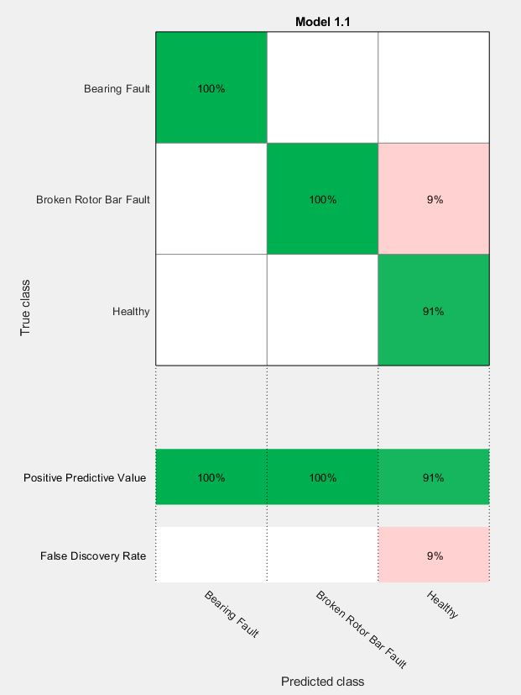
RESULTS
Confidence matrix of SVM trained model of current data at Quadratic & Cubic kernel functions

Slide 14
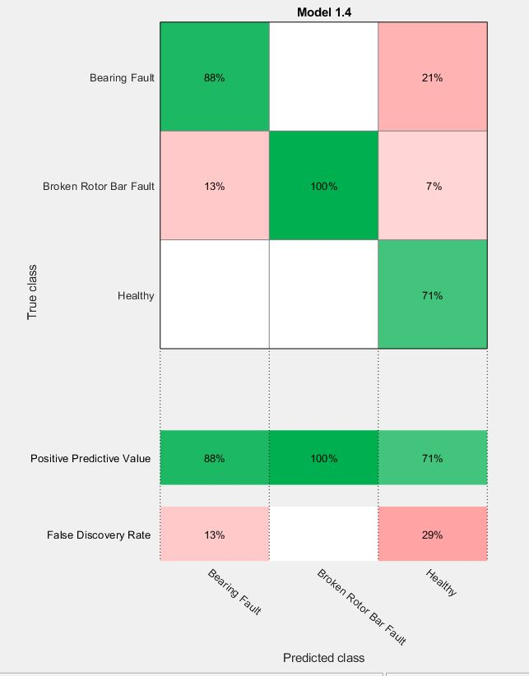
RESULTS
Confidence matrix of SVM trained model of current data at Fine Gaussian kernel functions

Slide 15
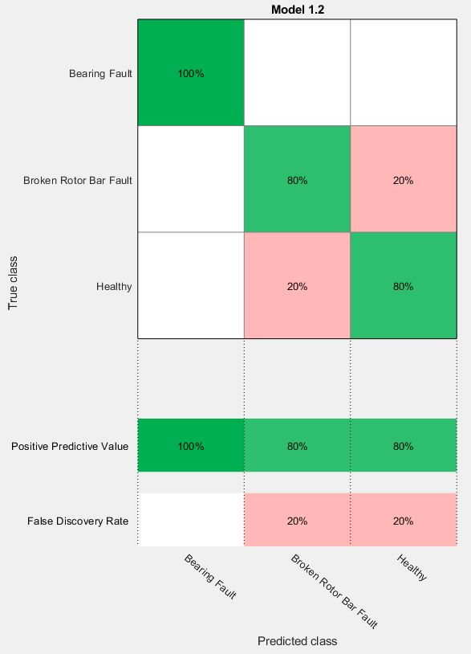
RESULTS
Confidence matrix of SVM trained model of vibration data at Quadratic & Cubic SVM kernel functions

Slide 16
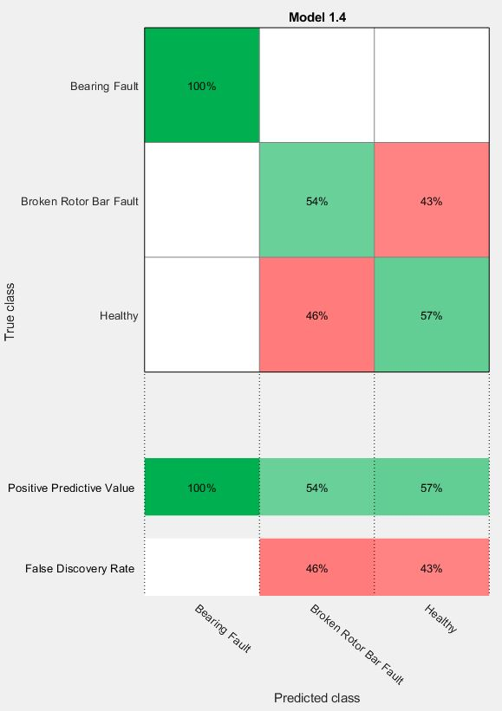
RESULTS
Confidence matrix of SVM trained model of vibration data at Fine Gaussian SVM kernel functions

Slide 17
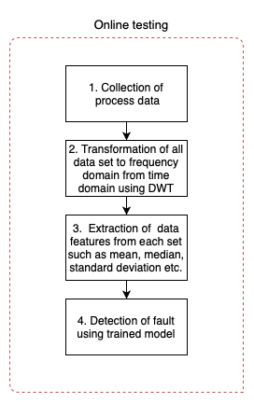
CONCLUSION
In this project, offline data training and testing is done to detect the fault.
Processing the raw data prior SVM model training is essential to achieve precise training and accuracy of fault detection using the trained SVM model.
Quadratic and Cubic SVM for both current and vibration have training accuracy above 85%.
Future work can be implementing the same methodology to perform online testing.
Online testing of data as a future work

Slide 18
ACKNOWLEDGEMENT
We would like to show our sincere gratitude to Dr. Syed Imtiaz for his guidance and valuable feedback, which helps to improve the overall quality of the project. Last but not the least Kawsar Zaman Shafi, Graduate Research Assistant, Memorial University, for his insights on these data as he collected the data.

Slide 19
REFERENCES
[1] S. Member and S. Member, “Experimental Investigation of Machine Learning Based Fault Diagnosis for Induction Motors Mohammad Zawad Ali Md Nasmus Sakib Khan Shabbir,” 2018 IEEE Ind. Appl. Soc. Annu. Meet., pp. 1–14, 2018.
[2] A. Widodo and B. S. Yang, “Application of nonlinear feature extraction and support vector machines for fault diagnosis of induction motors,” Expert Syst. Appl., vol. 33, no. 1, pp. 241–250, 2007.
[3] C. T. Kowalski and T. Orlowska-Kowalska, “Neural networks application for induction motor faults diagnosis,” in Mathematics and Computers in Simulation, 2003.
[4] O. A. Mohammed, N. Y. Abed, and S. Ganu, “Modeling and characterization of induction motor internal faults using finite-element and discrete wavelet transforms,” IEEE Trans. Magn., 2006.
[5] M. Aktas and V. Turkmenoglu, “Wavelet-based switching faults detection in direct torque control induction motor drives,” Iet Sci. Meas. Technol., 2010.
[6] O. A. Mohammed, N. Y. Abed, and S. Ganu, “Modeling and characterization of induction motor internal faults using finite-element and discrete wavelet transforms,” IEEE Trans. Magn., vol. 42, no. 10, pp. 3434–3436, 2006.
[7] V. Venkatasubramanian, R. Rengaswamy, S. N. Kavuri, and K. Yin, “A review of process fault detection and diagnosis part III: Process history based methods,” Comput. Chem. Eng., 2003.
[8] “MATLAB classifier application.” [Online]. Available: https://www.mathworks.com/help/stats/classificationlearner-app.html. [Accessed: 15-Jul-2019].
[9] C. W. Hsu and C. J. Lin, “A comparison of methods for multiclass support vector machines,” IEEE Trans. Neural Networks, 2002.
[10] T. Joachims, “Text categorization with support vector machines: Learning with many relevant features,” in Lecture Notes in Computer Science (including subseries Lecture Notes in Artificial Intelligence and Lecture Notes in Bioinformatics), 1998.
[11] D. C. Montgomery, Applied statistics and probability for engineers, 5th ed.. Hoboken, NJ: Wiley, 2011.
[12] J. F. MacGregor and T. Kourti, “Statistical process control of multivariate processes,” Control Eng. Pract., 1995.
[13] V. Vapnik and A. Vashist, “A new learning paradigm: Learning using privileged information,” Neural Networks, 2009.
[14] J. Platt, “Fast Training of Support Vector Machines using Sequential Minimal Optimization,” in Advances in Kernel Methods --- Support Vector Learning, 1999.
[15] X. L. Shafi Md Kawsar Zaman*, Hla U May Marma*, “Borken Rotor Bar Fault Diagnosis for Induction Motors Using Power Spectral Density and Complex Continuous Wavelet Transform Methods.”

Slide 20
Questions?

